Slide 1

Genome-scale metabolic models
Dr. Cheng Zhang
KTH-Royal Institute of Technology
http://sysmedicine.com

Slide 2
Genome-scale metabolic models (GEMs)
Concept of GEMs
Flux balance analysis
GEMs vs metabolic networks
Reconstruction of GEMs
Gene essentiality anlaysis
Reporter metabolite anlaysis
2

Slide 3
What is a GEM
Genome-scale metabolic models (GEMs) are mathematical reconstructions of the metabolic networks with all known metabolic reactions of many kinds of cells, including those of microorganisms, plants, and mammals.
In some cases, GEMs could represent the whole tissue or body of a multicellular organism.
In these metabolic networks, the gene-protein-reaction (GPR) relationships are annotated.
In addition, all the reactions in GEMs are mass-balanced, ensuring stoichiometric balance.

Slide 4
Concept of GEMs

Slide 5
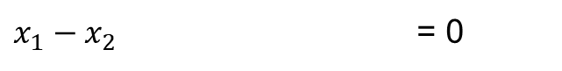
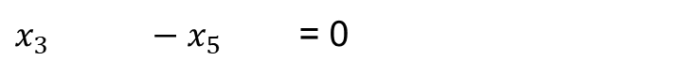
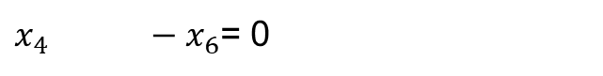
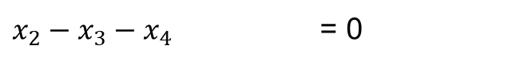
Flux balance analysis (FBA)
Pseudo-steady state assumption:
No accumulation of intra-cellular metabolite
S*v = 0
maximize Z = c*v
s.t. S*vi = 0
LBi<=vi<= UBi
$x_{1}−x_{2}$ = 0
$x_{2}−x_{3}−x_{4}$ = 0
$x_{4} −x_{6}$= 0
$x_{3} −x_{5}$ = 0
Under determined system!
Degree of freedom = No. of variables – No. of equations
Additional measurements $x_{1}$= 1 & $x_{5}$= 0
Objective function $x_{1}$= 1 & $maximize(x_{6})$

Slide 6
Flux balance analysis (FBA)

Slide 7
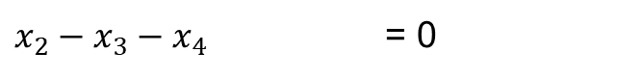
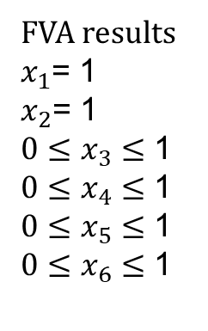
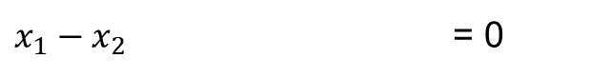
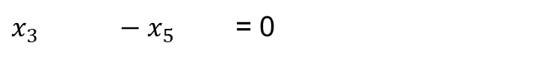
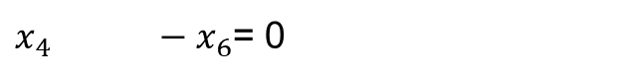
Flux variability analysis (FVA)
Flux variablity analysis (FVA) is the repetition of FBA which maximize and minimize each of the reaction with the defined constraints. FVA is usually used to examine the metabolic capability of a cell under specific condition.
$x_{1}−x_{2}$ = 0
R1
$x_{2}−x_{3}−x_{4}$ = 0
A
R2
$x_{4} −x_{6}$= 0
B
R3
R4
$x_{3} −x_{5}$ = 0
C
D
$x_{1}$= 1
R5
R6
FVA results
$x_{1}$= 1
$x_{2}$= 1
$0≤x_{3}≤$ 1
$0≤x_{4}≤$ 1
$0≤x_{5}≤$ 1
$0≤x_{6}≤$ 1

Slide 8
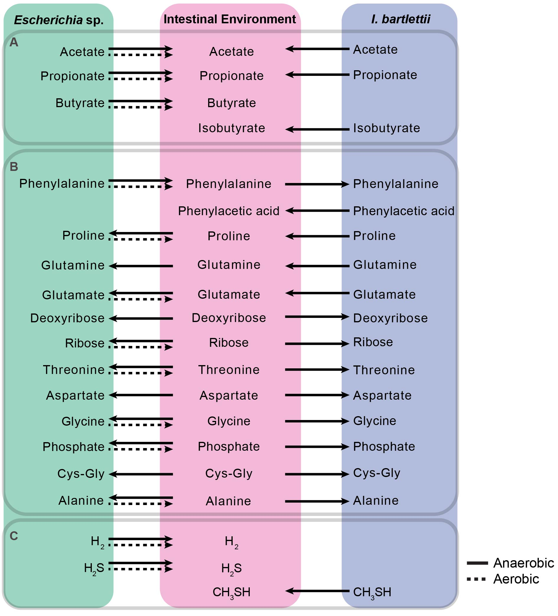
Flux variability analysis (FVA)

Slide 9
Parsimonious FBA (pFBA)
R1
A
R2
B
R3
R4
C
D
R6
R5
E
R7
F
R8
Parsimonious FBA is a special kind of FBA which minimizes the sum of all fluxes in a GEM with defined constraints. This special kind of FBA assumes the cells always executes in the most metabolically economic way. It is usually used with the original objective function of the cell fixed at its optimal flux.
minimize sum(v)
s.t. S*vi = 0
LBi<=vi<= UBi

Slide 10

Subjects with NAFLD
(N = 86)
In total 20 h (fasting conditions throughout experiment)
T=0h
T=4h
T=8h
12 h (overnight)
4 h
4 h
Study subjects with
Varies liver fat content
d3-leucine and d5-glycerol
injection for VLDL kinetics
Blood samples
T = 0h, 4h, 8h
T = 4h
T = 8h
Blood samples for
VLDL / apoB kinetics
Durham
Metabolomics
Sacramento
Lipidomics
(N = 73)
(N = 86)
(N = 78)
VLDL kinetics
Plasma Metabolomics
Plasma
Lipidomics
Mardinoglu et. al (2017), Mol. Syst. Bio., 13:916

Slide 11
Applications of GEMs
GEMs could be used to simulate the flux of different subject for comparison

Slide 12
Correlation of intracellular fluxes
with liver fat
Liver tissue
glucose[c]
3-phospho-D-glycerate[c]
pyruvate[c]
lactate[c]
PHGDH
NAD+[c]
NADH[c]
3-phosphonooxypyruvate[c]
PSAT1
glutamate[c]
BCAT1
TCA Cycle
AKG[c]
3-phosphoserine[c]
H2O[c]
PSPH
Pi[c]
Serine
Glycine
Betaine
Nacetylglycine
ADP[c]
Pi
Glycine[c]
SHMT1
serine[c]
ATP[c]
Glutamine[c]
Glutamate[c]
gamma-glutamyl-
cysteine[c]
GSH[c]
GCLC
GCLM
GSS
ATP[c]
ADP[c]
Pi
Cysteine[c]
NADH[m]
Mitochondria
NNT
NADP+[m]
2 GSH[m]
H2O2[m]
H+[c]
MMR_4271
H+[m]
GSR
MMR_3870
MMR_4121
CAT
NADPH[m]
2 H2O[m]
O2[m]
Blood
GSSG[m]
Cytoplasm
NAD+[m]
Blue colour indicates down regulation of the genes.
12
Mardinoglu et. al (2017), Mol. Syst. Bio., 13:916

Slide 13
Difference between topology and stoichiometric matrix
R1
R1
R1
?
?
A
A
A
R2
R2
R2
B
B
B
R3
R4
R3
R3
C
D
C
D
C
D
R5
R6
R5
R5
R4
R4
B = C+D
B = 2C+D

Slide 14
GEMs vs metabolic networks
Metabolic networks with only topolocal info will miss ADP and ATP as required input and output, respectively

Slide 15
GEMs vs metabolic networks
Result shows that model based flux balance analysis exhibited better prediction compared to network based analysis

Slide 16
Reconstruction of genome-scale metabolic models
An organism’s reactome can be assembled in a way that is analogous to DNA-sequencing assembly. (Right to left) First the interacting compounds must be identified. Then, the reactions acting on these compounds are tabulated and the protein that catalyzes the reaction and the corresponding open reading frame is identified in the organism of interest. These reactions are assembled into pathways that can be laid out graphically to visualize a cell’s metabolic map at the genome scale.
16

Slide 17
Reconstruction of genome-scale metabolic models for human
17

Slide 18
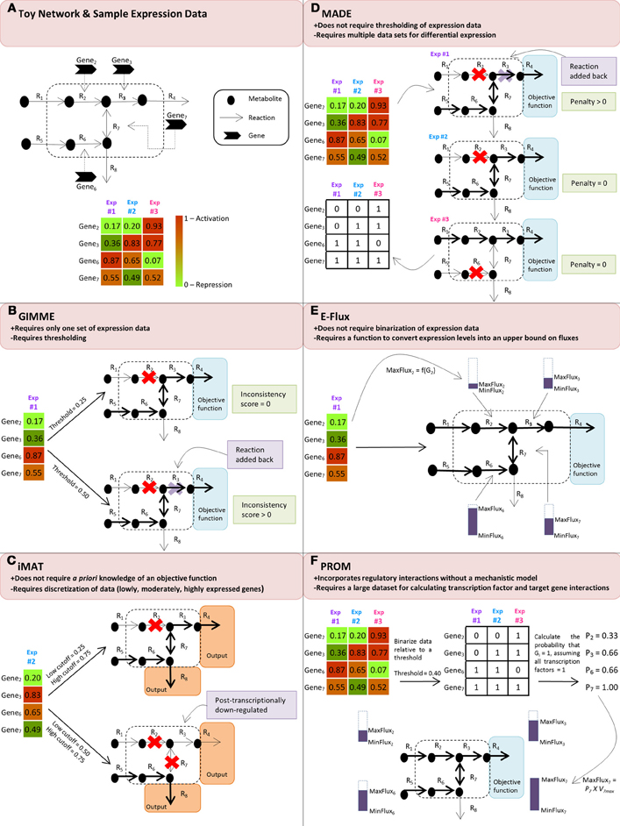
Reconstruction of genome-scale metabolic models

Slide 19
INIT algorithm
The hierarchical structure of GEMs is characterized by its gene-transcript-protein reaction (GTPR) associations. In GEMs, each metabolic reaction is associated to one or more enzymes, which in turn are associated to transcripts and genes. Depending on the evidence for presence/absence of a given enzyme/gene in a cell type, a score can be calculated for the reaction(s) catalyzed by that enzyme. The HPA evidence scores are illustrated as red, light, medium and dark green representing negative, weak, moderate and strong evidence, respectively. The transcriptome evidence scores (GeneX), which are illustrated as red, light, medium, and dark blue representing low, medium and high expression, respectively. No evidence is present as white object.
For some metabolites (yellow filled circle), metabolomic data are available to prove that they are present in the considered cell type. The aim of the algorithm is to find a sub-network in which the involved genes/proteins have strong evidence supporting their presence in the cell type under consideration. This is done by maximizing the sum of evidence scores. All the included reactions should be able to carry a flux and all the metabolites observed experimentally should be synthesized from precursors that the cell is known to take up.

Slide 20
Task driven INIT
tINIT was used for reconstructing GEMs which are in agreement with omics data and which could perform a set of predefined tasks. In this illustration, the model should perform two simple tasks; production of “D” from “A” and “E” from “B.” The resulting model should contain as many of the green reactions and as few of the red ones as possible. In the first step, all reactions were identified which, if removed from the network, cause any of the tasks to fail. These reactions were marked blue. In the second step, the INIT algorithm was used to find the network with the maximal number of green reactions compared to red, with the additional constraints that the model must be functional and that all blue reactions must be included. This would result in the dotted reactions being removed from the network. At this stage, the first task would be possible, but not the second one (since uptake of “C” makes the production of “E” possible without using any red reactions). In the final step, each task was tested and a gap-filling algorithm was used to reinsert the reactions which were required for all tasks to work. This would result in the inclusion of the lower-most red reaction.

Slide 21
Essentiality analysis
GEMs could be used to simulate the metabolic phenotype after gene/reaction knockouts
R1
R1
A
R2
This could be used to identify anti-cancer siRNA
R2
B
R3
R4
C
D
R6
R5
E
R7
F
R8
R8

Slide 22
Essentiality analysis

Slide 23
Essentiality analysis
GEMs could also be used to predict the phenotype after metabolite removal, which could be potential anti-metabolite target for cancer treatment

Slide 24
Reporter metabolites
G1
G4
G2
G2
G5
G1
A
B
G3
G6
G3
In order to properly capture the connection between expression and network topology, we must determine whether the aggregated z score of a subnetwork is higher than expected relative to a random set of genes (drawn from the same expression data but independently of the network). We randomly sample gene sets of size k using a Monte Carlo approach, compute their aggregated scores, then use these to derive estimates for the mean score and standard deviation.

Slide 25
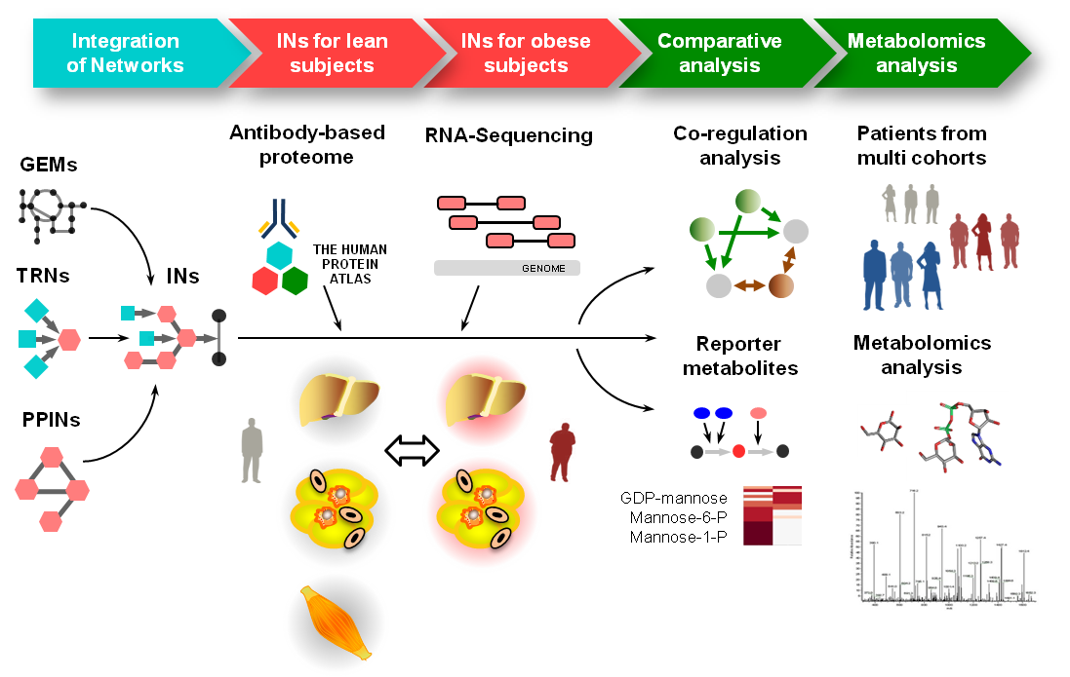
Reporter metabolites
Lee et. al (2016), Cell Metabolism, 24, 172-184
25

Slide 26
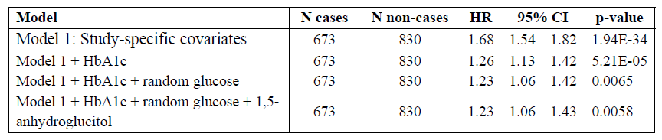
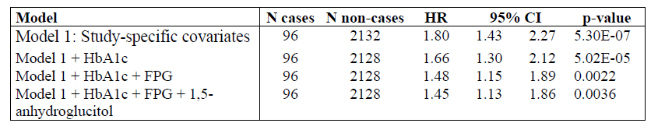
Reporter metabolites
Association of mannose levels and incident T2D in 4,000 well phenotyped subjects
The EPIC-Norfolk STUDY
METSIM STUDY
Mardinoglu et. al (2017), Cell Metabolism, 26, 281-283

Slide 27









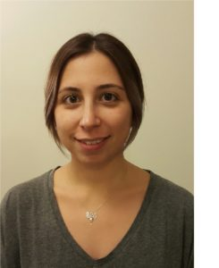
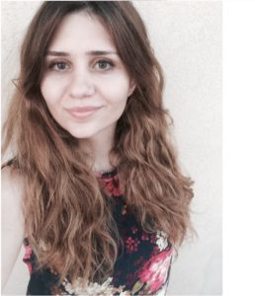

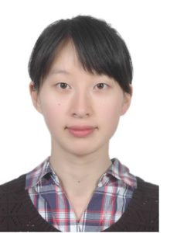


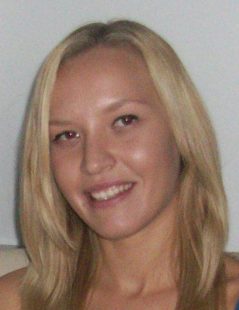
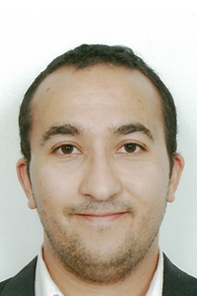



Systems medicine group@ SciLifeLab
Computational Biology
Cheng Zhang
Senior Researcher
Sunjae Lee
Senior Researcher
Ida Larsson
MSc Student
Reza Bidkhori
Post doc
Rui Benfeitas
Post doc
Muhammad Arif
PhD stud.
Alen Lovric
Research Eng
Dorines Rosario
Research Eng
Mohamed Alshobky
MSc Student
Experimental Biology
Beste Turanli
Vis Student
Feride Eren
Vis Student
Ozlem Altay
Vis Resarcher
Shuqi Zhang
Vis Resarcher
Zhengtao Liu
Post doc
Woong Hee Kim
Post doc
Natasa Sikanic
Researcher
Medicinal Chemistry
Computational Chemistry
Faddy Aziz
Post doc
Umberto Battisti
Post doc
Chiara Zagni
Post doc
Anders Füchtbauer
Post doc
Leticia Gómez
Post doc
Chunxia Gao
Post doc

Slide 28
Acknowledgements
SciLifeLab
Prof. Mathias Uhlen
Ass. Prof. Emma Lundberg
Ass. Prof. Simon Elsässer
Chalmers University of Technology
Prof. Jens Nielsen
University of Groningen
Albert K. Groen
University of Gothenburg
Prof Jan Boren
Prof Ulf Smith
Prof. Fredrik Bäckhed
Prof. Lena M Carlsson
Prof. Stefano Romeo
Prof. Morten Grötli
Prof. Leif Eriksson
University of Amsterdam
Mireille J. Serlie
King's College London
Ass. Prof. Saeed Shoaie
Stanford University
Prof. Michael Snyder
Dr Brian D Piening
NIH
Prof. George Kunos
Dr Resat Cinar
Bani Mukhopadhyay
Helsinki University
Prof Marja-Riitta Taskinen
Imperial College London
Prof. Philippe Froguel
Prof. Andrew J Walley
University of Leipzig
Prof. Matthias Blüher

Slide 29






Acknowledgements
29

